Slide 1

KICK OFF MEETING
<PROJECTNUMBER> <PROJECTNAME>

Slide 2
AGENDA
Review Team Roles / Introductions
Review Project Business Drivers
Review Scope of Work
Review Key Schedule Drivers and Schedule Risks
Communication Plan
Project Methodology
Review Company Standards
Identify Risks
Additional Items?
Next Steps
Notes:
-The purpose of this meeting is to get an initial understanding of who the stakeholders are and their roles.
-We then want to understand the business drivers that lead to the project. We want to hear insight from sales on business drivers and continued sales strategy.
-We also want to review the current proposal to make sure everyone has an overall understanding of the project and it's deliverables. As we review the proposal, let's highlight any risks we see.
-Anyone who has any experience with the client will want to provide insight on what it is like to work with the client.
-Depending upon the client, some may have very formal standards and some no standards. We want to get an idea of where this client falls on the spectrum.
-We'll conclude our time with our next steps.

Slide 3
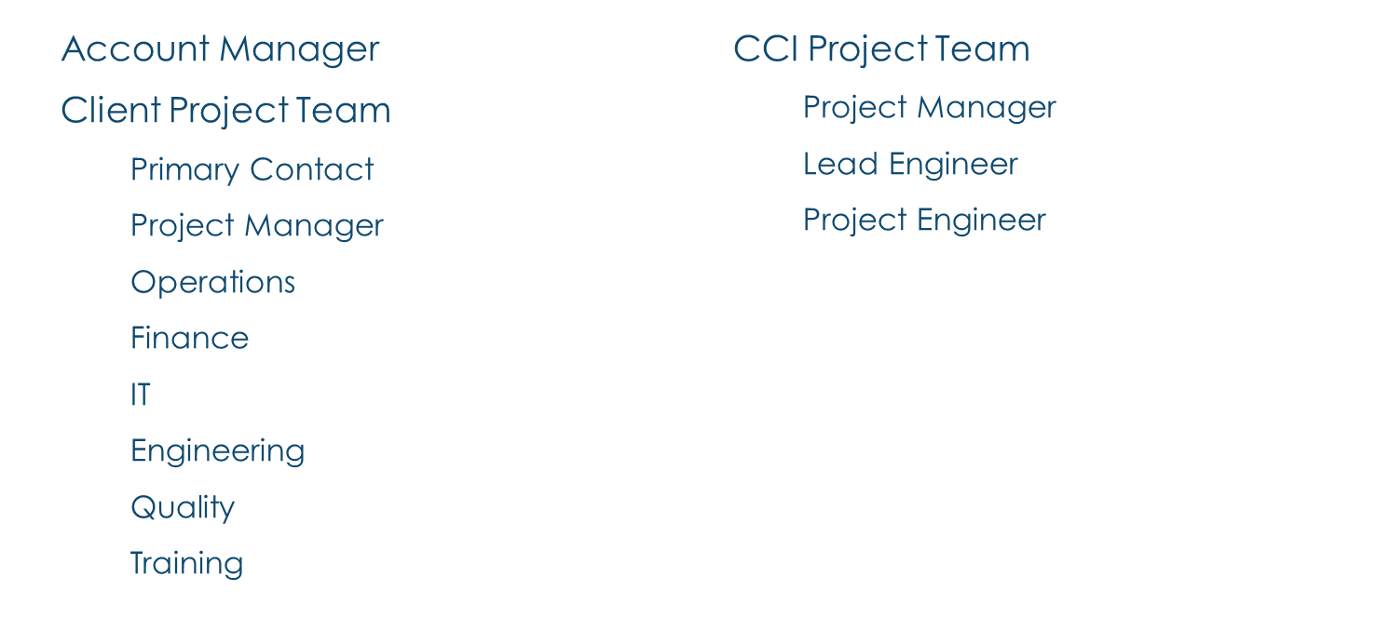
REVIEW TEAM ROLES / INTRODUCTIONS

Slide 4
PROJECT BUSINESS DRIVERS
Project Business Purpose
Key Business Drivers
Stakeholders: People, Partners & Vendors

Slide 5
SCOPE OF WORK
Scope Of Work
  Parties Responsible
Deliverables
  Parties Responsible
  Approval Cycles
  Shipping Invoicing
Assumptions & Constraints
  Timely Reviews/Approvals
  Needed Designs & Specifications
Invoicing

Slide 6
REVIEW KEY DRIVERS AND SCHEDULE RISKS
Planned Shutdowns
Order Lead Times
Approval Process
Resource Availability
Fiscal Year Budget Constraints

Slide 7
COMMUNICATION PLAN
Approval Authority
Primary Contact
Security And Safety Items
Status Meetings
  Every 2 weeks
Status Reports
  Every 2 weeks
Technical Communications
  Copy PM & Primary Contact

Slide 8
PROJECT METHODOLOGY
Project Approach
  Waterfall Approach
Notes:
For DCS project we take a traditional waterfall approach: Requirements, Design, Develop, Test
For MES projects we utilize waterfall methodology for interfaces, final development, and testing. However, recipe development involves input from operations, engineering and quality. It’s very difficult to determine “how” Syncade will fulfill requirements without early prototyping. Prototyping sessions are setup as Workshops. It’s important that ALL representatives from operations, engineering, and quality attend and review the current iteration of requirements and design. There are only 4 workshops. Workstreams are sub projects that take place simultaneously with the project and must coordinate with each other.

Slide 9
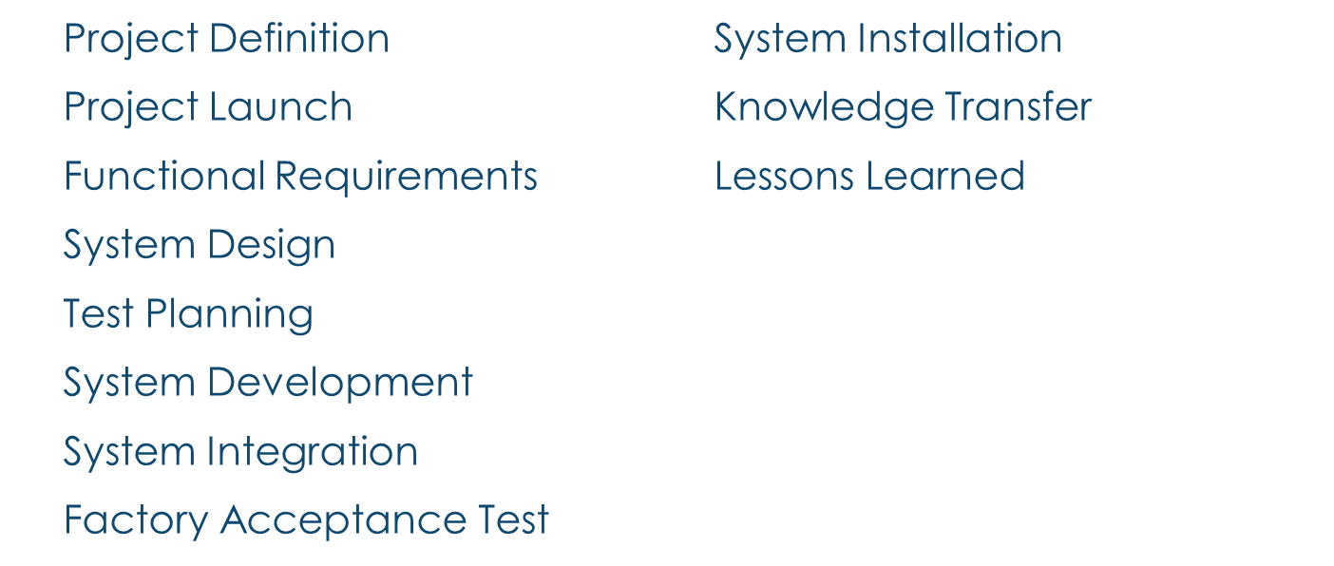
PROJECT METHODOLOGY – DCS PROJECTS
Notes:
FUNCTIONAL REQUIREMENTS
Cornerstone Controls will provide a functional requirements document for customer review. This document will describe “WHAT” the designed system will be required to do.
SYSTEM DESIGN
Cornerstone Controls will provide a functional requirements document for customer review. This document will describe “HOW” the designed system will be required to do.
TEST PLANNING
Cornerstone will establish test plans intended to verify that the completed system meets the functional requirements.
SYSTEM INTEGRATION
The system integration phase may occur at the staging site (Cornerstone’s office)
FACTORY ACCEPTANCE TEST
Using the simulation tools referenced in the preceding section and based on the test plan previously approved by the customer.
SYSTEM COMMISSIONING
System commissioning will be a joint effort between the customer, Cornerstone, and other third-party vendors.
KNOWLEDGE TRANSFER
Cornerstone and Emerson will provide several types of documentation training for the system as outlined in proposal.

Slide 10
COMPANY STANDARDS
Drafting
Programming
Testing
Documentation
Other Corporate

Slide 11
IDENTIFY RISKS
Resource Availability
Approval Process
Product Lead Times
Unknown Scope

Slide 12

ADDITIONAL ITEMS?

Slide 13
NEXT STEPS

